Slide 1
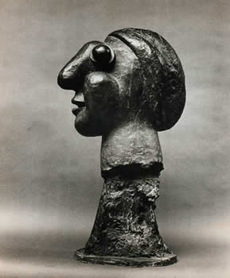
Class 3
From 3D to 2D
and
From 2D to 3D

Slide 2


Login to Pollev.com/yaelmoses099

Slide 3
Today
Edges:
Sobel
Canny edge detector
Geometry
From 3D to 2D
and back

Slide 4
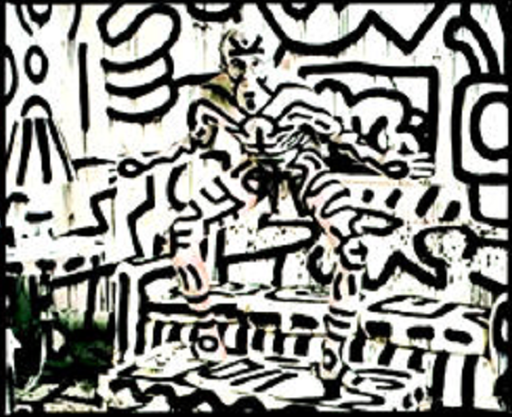
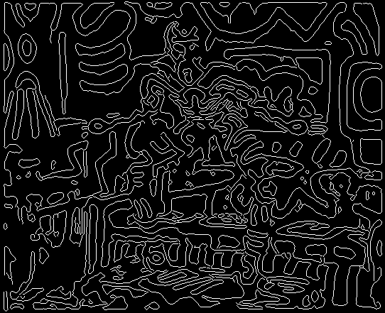
Intensity Edge
An image contour along a change in surface brightness/color
Keith Haring by Annie Leibovitch

Slide 5
Basic Algorithms
Sobel (~1968)
Canny (1986)
CNN – not in this course
Reference J. Canny, “A Computational Approach to Edge Detection,” IEEE Trans. Pattern Analysis and Machine Intelligence, vol. 8, pp. 679-698, 1986

Slide 6
An edge point
I(200,:)
From Heads
by A. Kayser

Slide 7
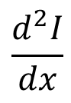
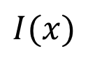
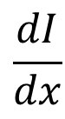
Differential Operators: 1D
An edge point is located on
the maximum of gradient
(in 2D -in some direction)
First derivative:
maximum (or minimum)
Second derivative:
zero-crossing
$$I(x)$$
$$\frac{dI}{dx}$$
$$\frac{d^{2}I}{dx}$$
0

Slide 8
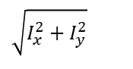
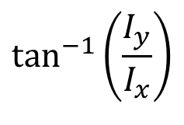
Using a Differential Operator
For each point compute the edge magnitude and orientation
An edge point: the maximum magnitude
Edge orientation: orthogonal to the gradient
$$\tan^{−1}\left(\frac{I_{y}}{I_{x}}\right)$$
$$\sqrt{I_{x}^{2}+I_{y}^{2}}$$

Slide 9
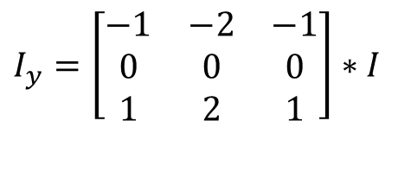
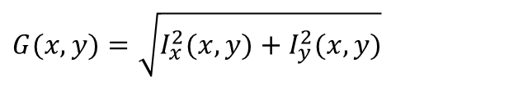
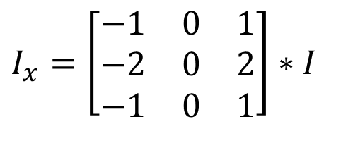
Sobel Edge Detector (1968)
1. Convolve the image with following masks:
2. Estimate gradient magnitude:
3. Mark G(x,y) > threshold
$$I_{y}=\left[\begin{matrix}−1 & −2 & −1 \\ 0 & 0 & 0 \\ 1 & 2 & 1\end{matrix}\right]∗I$$
$$I_{x}=\left[\begin{matrix}−1 & 0 & 1 \\ −2 & 0 & 2 \\ −1 & 0 & 1\end{matrix}\right]∗I$$
$$G(x,y)=\sqrt{I_{x}^{2}(x,y)+I_{y}^{2}(x,y)}$$
Notes:
The sobel mask is simply a convolution of the image with -1 1 and smoothing with 1 1
-1 1 1 1
To show them how it works.
Q: what kind of edges will hav high value? Low value? Absolote high value?

Slide 10
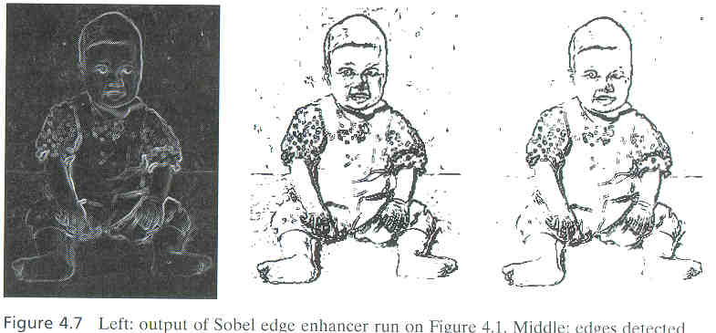
Sobel edge
Enhancer
Threshold 35
Threshold 50

Slide 11
Limitations of Sobel?

Slide 12
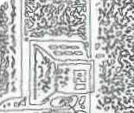
Canny Edge-Detector
Noise smoothing:
Gaussian
Canny Enhancer:
Image gradients
Edge thinning:
Non-maximum suppression
Connected edge contours
Hysteresis threshold

Slide 13
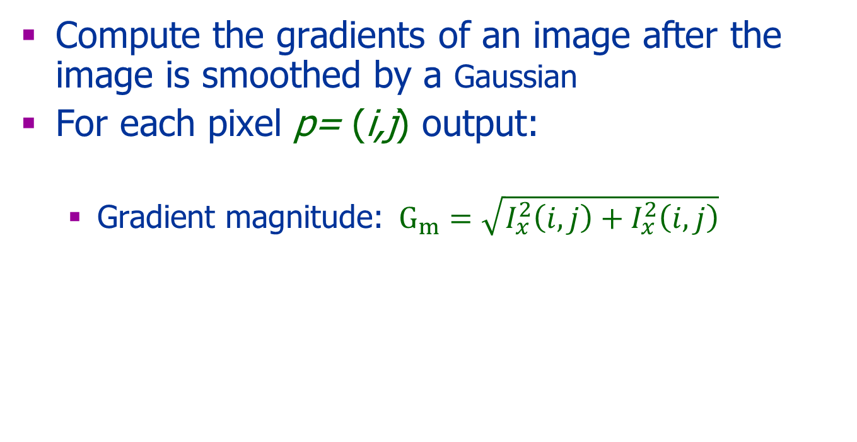
Canny Enhancer
Compute the gradients of an image after the image is smoothed by a Gaussian
For each pixel p= (i,j) output:
Gradient magnitude: $G_{m}=\sqrt{I_{x}^{2}\left(i,j\right)+I_{x}^{2}\left(i,j\right)}$

Slide 14
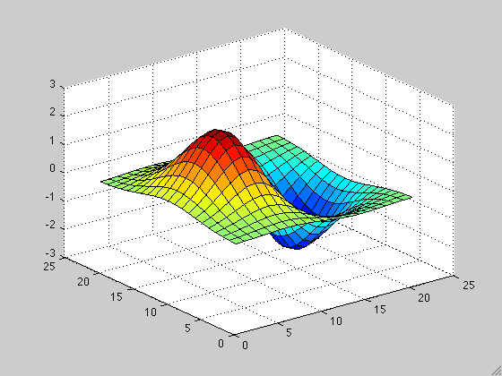
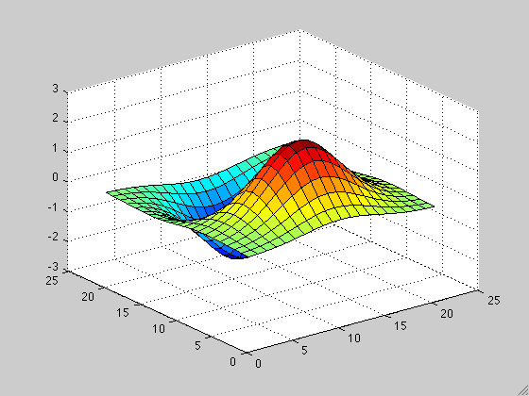
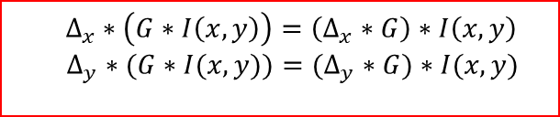

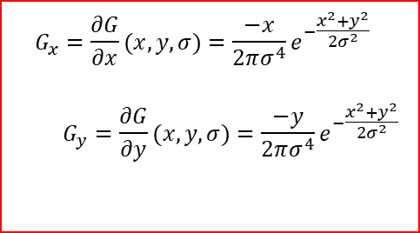
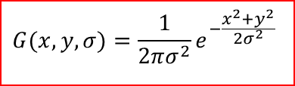
Smoothing & Taking Derivatives
$$Δ_{x}∗\left(G∗I\left(x,y\right)\right)=\left(Δ_{x}∗G\right)∗I\left(x,y\right)$$
$$Δ_{y}∗(G∗I(x,y))=(Δ_{y}∗G)∗I(x,y)$$
$$G(x,y,σ)=\frac{1}{2πσ^{2}}e^{−\frac{x^{2}+y^{2}}{2σ^{2}}}$$
$${ Δ}_{x}∗\left(G∗I\left(x,y\right)\right)=G_{x}∗I\left(x,y\right)$$
$$Δ_{y}∗(G∗I(x,y))=G_{y}∗I(x,y)$$
$$G_{x}=\frac{∂G}{∂x}(x,y,σ)=\frac{−x}{2πσ^{4}}e^{−\frac{x^{2}+y^{2}}{2σ^{2}}}$$ $$G_{y}=\frac{∂G}{∂y}(x,y,σ)=\frac{−y}{2πσ^{4}}e^{−\frac{x^{2}+y^{2}}{2σ^{2}}}$$
Associativity
Scale

Slide 15


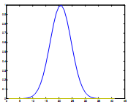
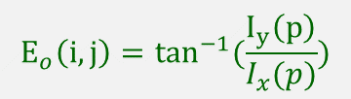
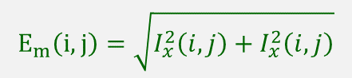
Thinning
Edge Direction
Non-maximum Suppression
A single point along the edge normal
Edge Normal
Edge magnitude
Edge normal
$$E_{m}\left(i,j\right)=\sqrt{I_{x}^{2}\left(i,j\right)+I_{x}^{2}\left(i,j\right)}$$
$$E_{o}\left(i,j\right)=\tan^{−1}(\frac{I_{y}\left(p\right)}{I_{x}(p)})$$

Slide 16
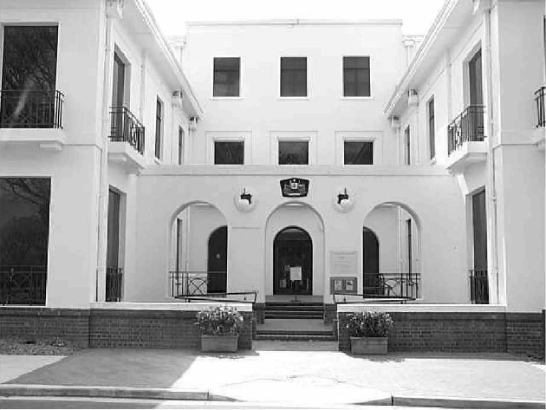
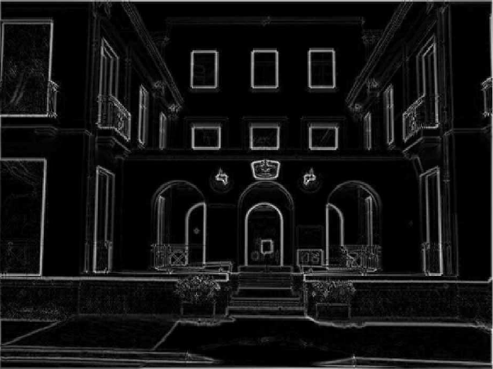
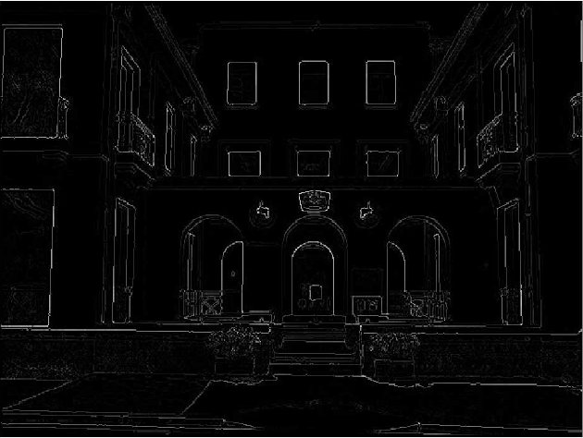
Thinning: Non-Maximum Suppression
courtesy of G. Loy
Original image
Gradient magnitude (canny enhancer)
Non-maxima
suppressed
Slide credit: Christopher Rasmussen

Slide 17
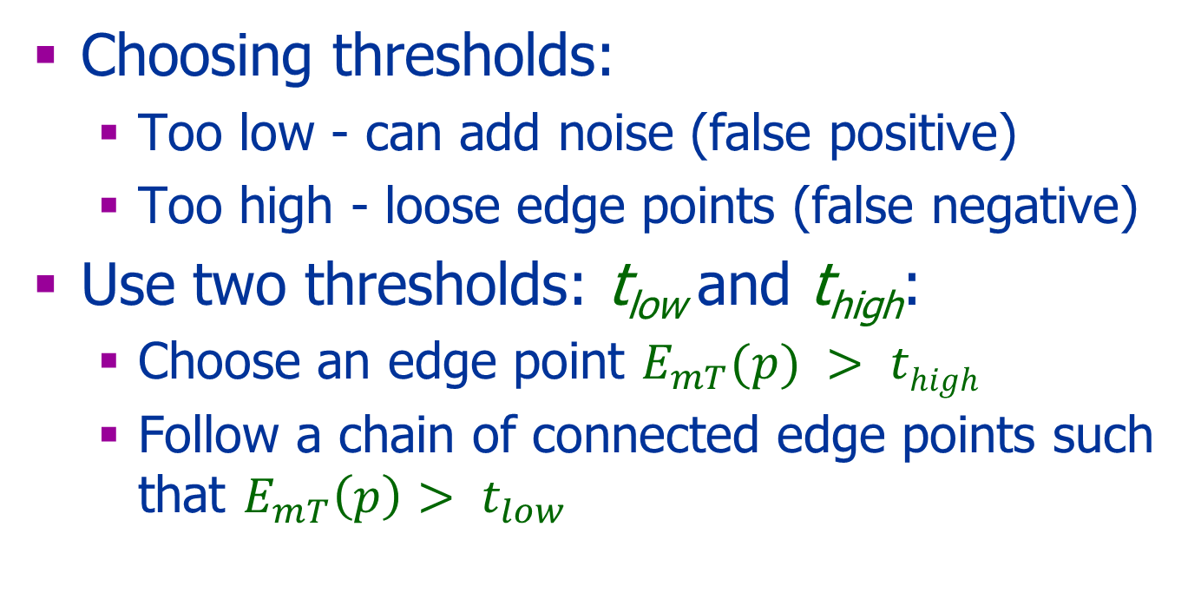
Hysteresis Threshold
Choosing thresholds:
Too low - can add noise (false positive)
Too high - loose edge points (false negative)
Use two thresholds: t_{low} and t_{high}:
Choose an edge point $E_{mT}(p) > thigh$
Follow a chain of connected edge points such that $E_{mT}\left(p\right)> t_{low}$

Slide 18
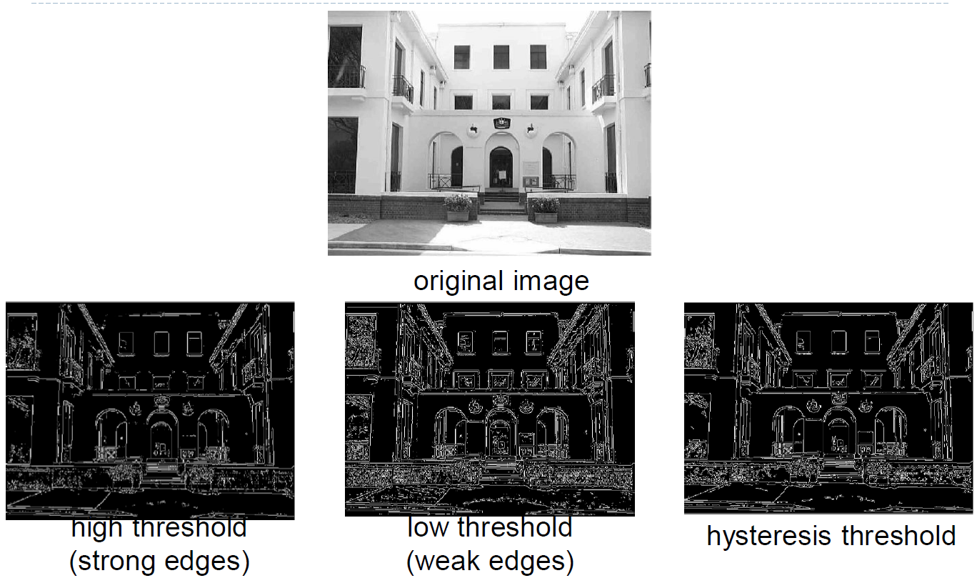
Hysteresis Threshold

Slide 19
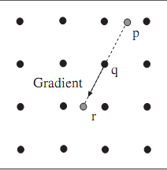
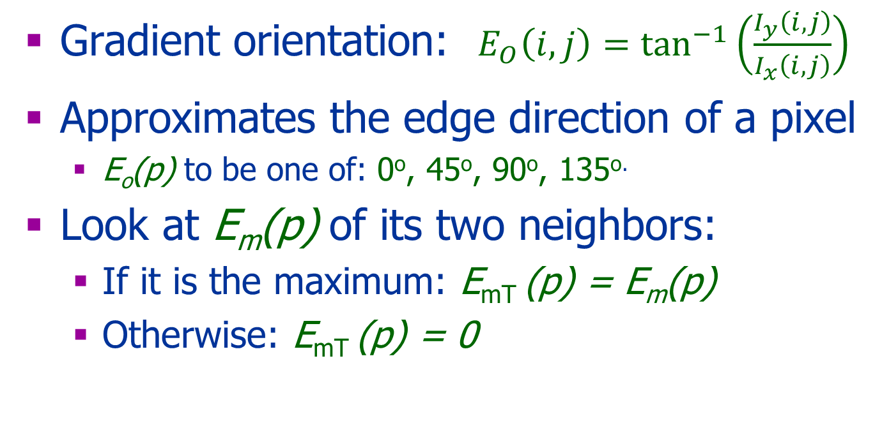
Implementation Details
Gradient orientation: $E_{O}\left(i,j\right)=\tan^{−1}\left(\frac{I_{y}\left(i,j\right)}{I_{x}\left(i,j\right)}\right)$
Approximates the edge direction of a pixel
E_{o}(p) to be one of: 0º, 45º, 90º, 135^{o.}
Look at E_{m}(p) of its two neighbors:
If it is the maximum: E_{mT} (p) = E_{m}(p)
Otherwise: E_{mT} (p) = 0
r’

Slide 20
The Parameters
Smoothness, σ
Thresholds: high & low

Slide 21
Summary: Canny Edge-Detector
Convolve with a derivative of a Gaussian (Compute derivatives of the image after smoothing it with a Gaussian)
Canny Enhancer: gradient magnitude
Thinning: Non-maximum suppression
Hysteresis threshold:
Connected edge contours

Slide 22
Evaluation
Good detection minimizes:
False negatives, the failure to detect edge pixels
False positives, the detection of a non edge pixels
Good localization:
Edges must be as close as possible to the true edges
Single response constraints:
One point for each true edge point

Slide 23
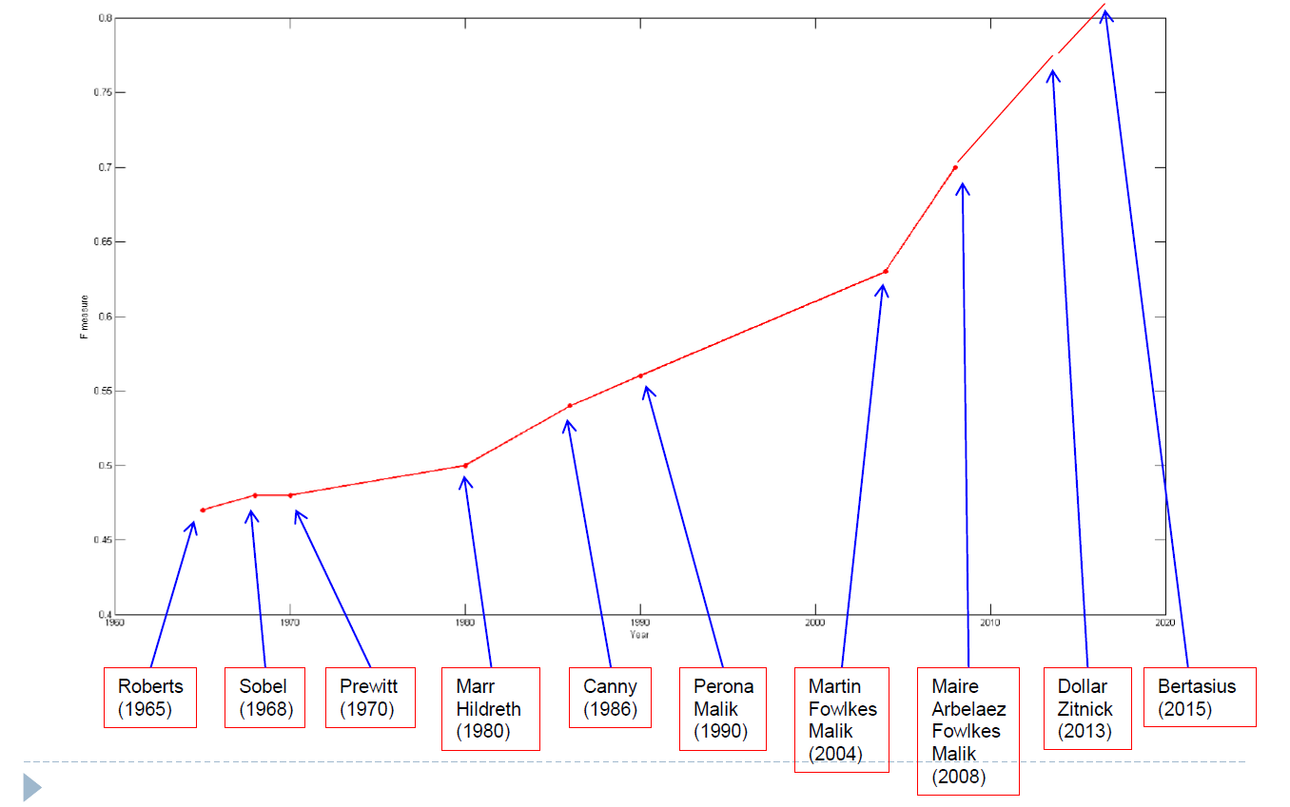
Progress

Slide 24
Using Edge or Feature Points
Matching between images
Segment objects
Finding parametric shape

Slide 25
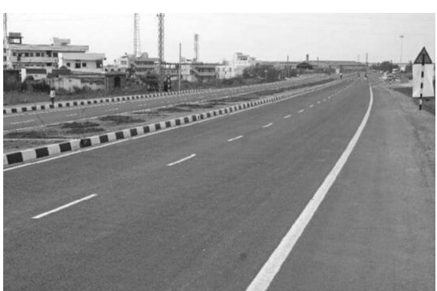
Using Edge or Feature Points
Finding parametric shape
A straight line
A circle
Etc
How?
Hough transform
RANSAC

Slide 26

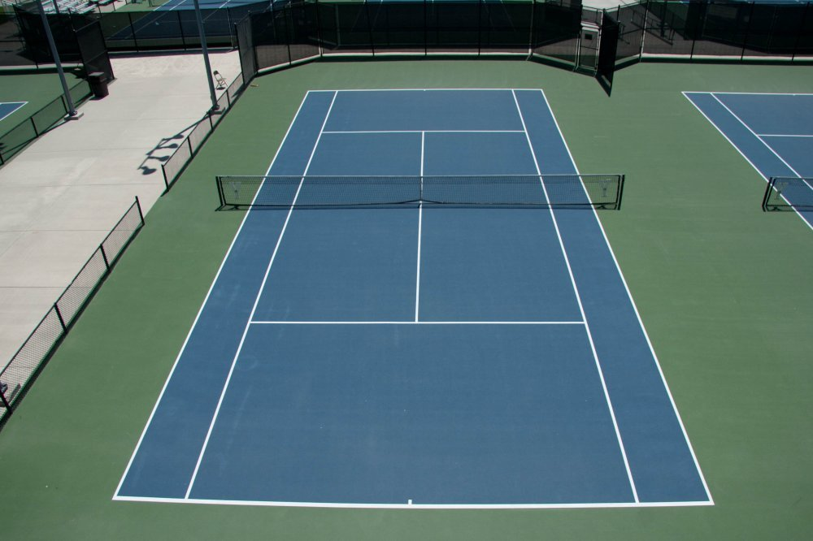
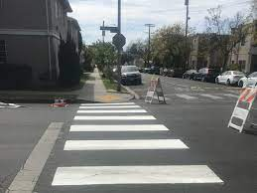
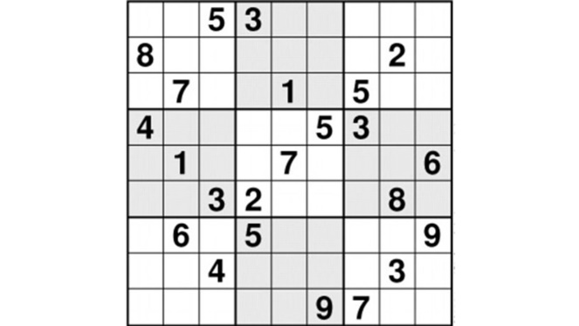
Straight Lines

Slide 27
Straight Line
Input:
A set of corners
A set of edge points
Output:
A set of straight lines
Algorithms:
Hough Transform
RANSAC

Slide 28
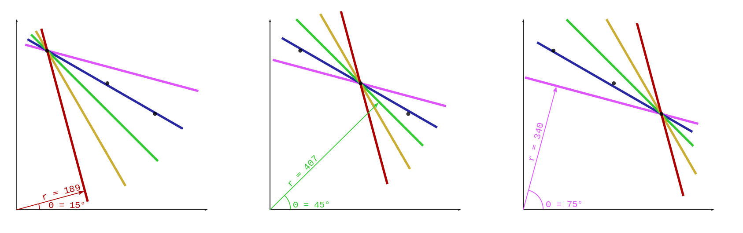
Hough Transform
Voting:
Consider all lines pass through each point
Vote for a line with ‘many’ points
Taken from WIKI

Slide 29
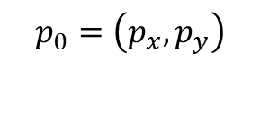
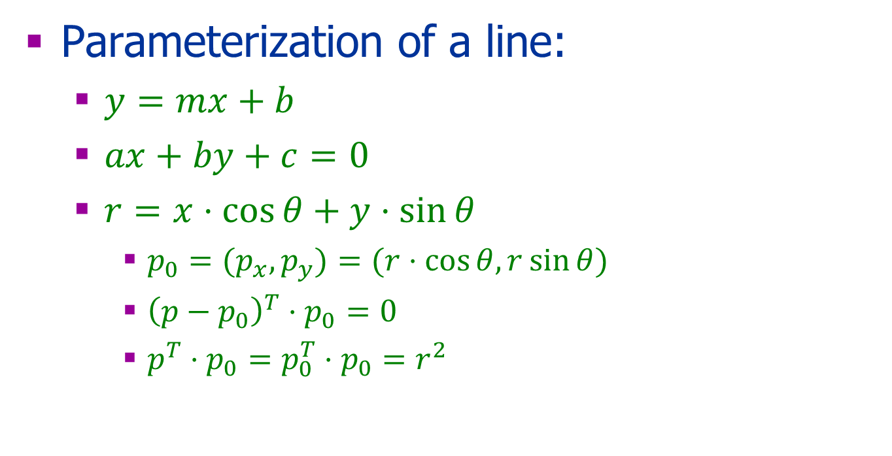
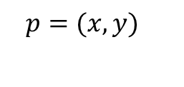
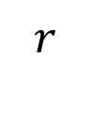
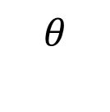
Hough Transform
Parameterization of a line:
$y=mx+b$
$ax+by+c=0$
$r=x⋅\cos{θ}+y⋅\sin{θ}$
${p_{0}=(p}_{x},p_{y})=(r⋅\cos{θ,}r\sin{θ})$
${\left(p−p_{0}\right)}^{T}⋅p_{0}=0$
$p^{T}⋅p_{0}=p_{0}^{T}⋅p_{0}=r^{2}$
$${p=(x,y)}_{}$$
$$p_{0}=\left(p_{x},p_{y}\right)$$
$$r$$
$$θ$$

Slide 30
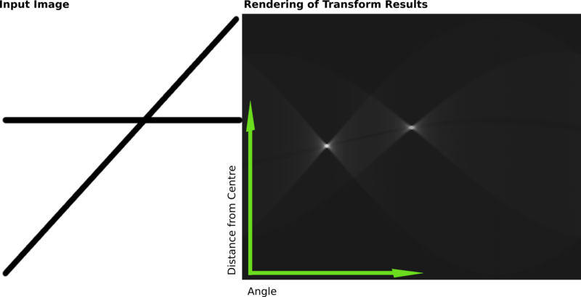
Example
Taken from WIKI

Slide 31
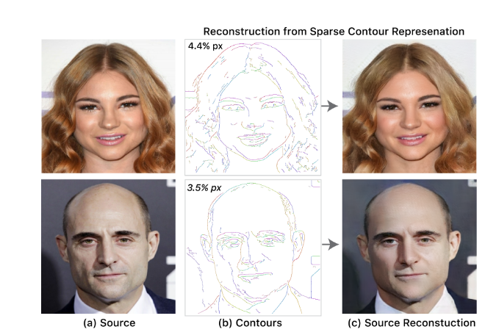
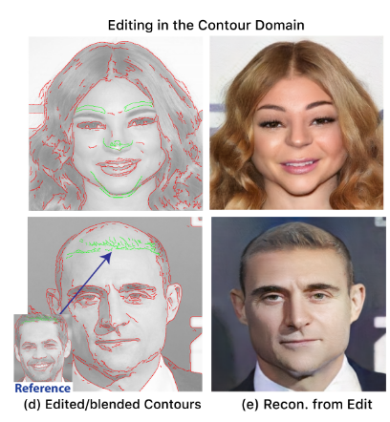
Additional Application
Sparse, Smart Contours to Represent ans manipulate images Dekel et al 2018 proj
video t30
Demo

Slide 32
Other Types of Edges
Step edges
Roof Edges
Line Edges

Slide 33
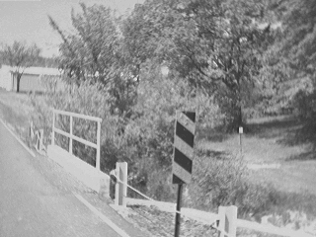
What causes an edge?
Depth discontinuity
Surface orientation discontinuity
Reflectance discontinuity (i.e., change in surface material properties)
Illumination discontinuity (e.g., shadow)
Slide credit: Christopher Rasmussen

Slide 34
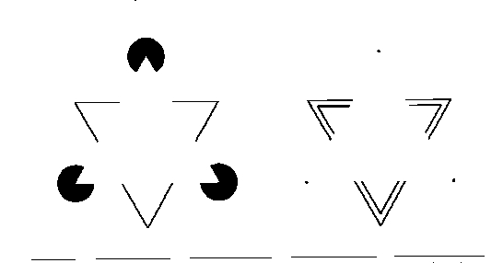
Illusory Contours

Slide 35

Other Edges
Discontinuity in depth
Discontinuity in texture
Discontinuity in motion

Slide 36
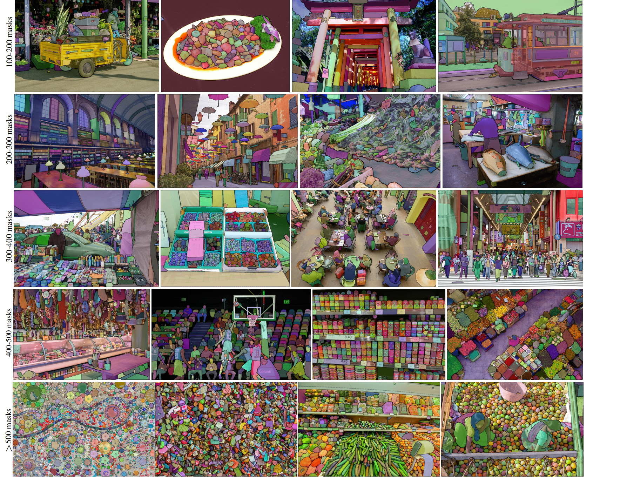
Edges - Segmentation
Segment Anything, Kirillov et al 2023

Slide 37
Bibliography
A computational approach to edge detection, Canny, Readings in computer vision: issues, problems, principles, and paradigms, 1987
Forsyth & Ponce, chapter 8
Additional reading for a broader picture: Szeliski, chapter 4

Slide 38
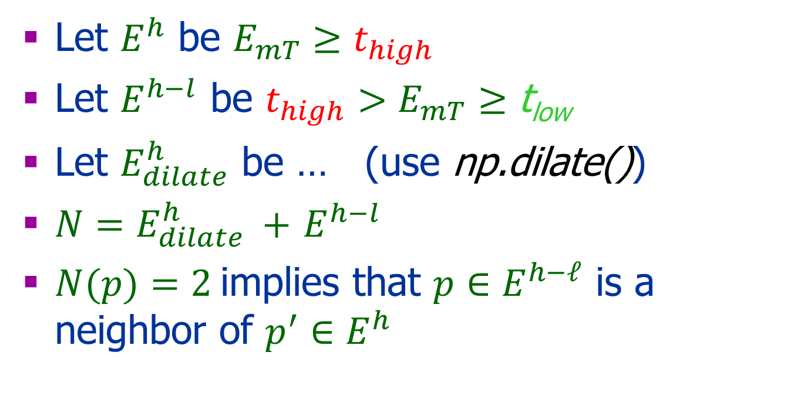
Implementations Issues Vectorize Solution
Let $E^{h}$ be $E_{mT}≥t_{high}$
Let $E^{h−l}$ be ${t_{high}>E}_{mT}≥\text{t}\text{low}$
Let $E_{dilate}^{h}$ be … (use np.dilate())
${N=E}_{dilate}^{h} +$ $E^{h−l}$
$N(p)=2$implies that $p∈E^{h−ℓ}$ is a neighbor of $p^{′}∈E^{h}$

Slide 39
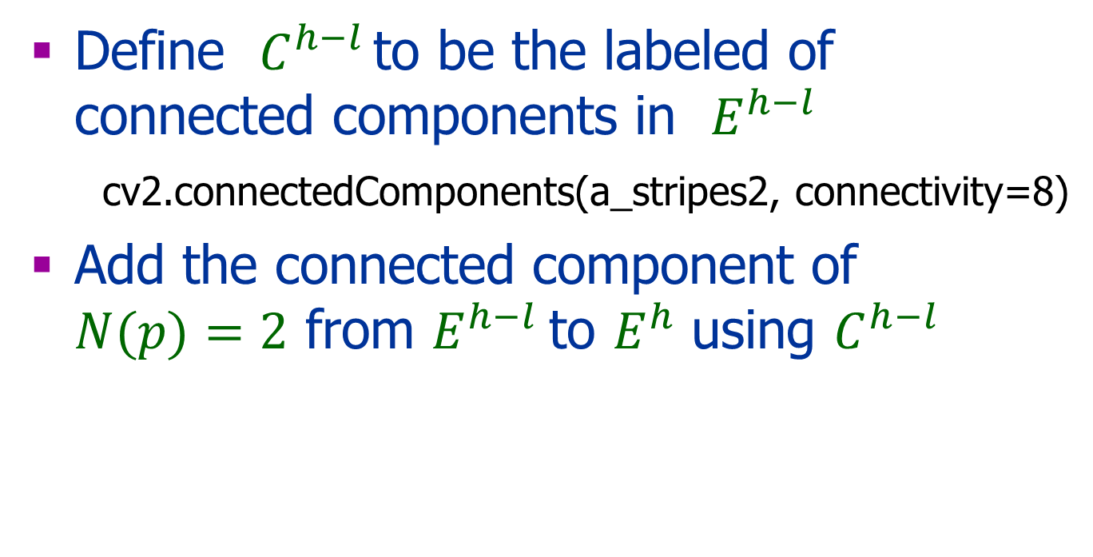
Cont.
Define $C^{h−l }$to be the labeled of connected components in $E^{h−l}$ cv2.connectedComponents(a_stripes2, connectivity=8)
Add the connected component of $N(p)=2$ from $E^{h−l}$to $E^{h}$ using $C^{h−l }$

Slide 40


Let $E^{h}$ be $E_{mT}≥t_{high}$
Let $E^{h−l}$ be ${t_{high}>E}_{mT}≥\text{t}\text{low}$

Slide 41


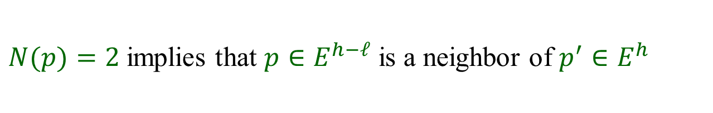

 |  | 1 | 1 | 1
 |  | 1 | 1 | 1
 |  | 1 | 1 | 1
 |  | 1 | 1 | 1
 |  | 1 | 1 | 1
 | 1
 | 1 |  |  | 1 | 1 | 1
 | 1
 | 1
 |  | 1 | 1 | 1
 |  | 1 | 1 | 1
 | 1 | 1 | 1 | 1
 | 1 | 1 | 1 | 2 | 1 | 1
 | 1 | 1 | 1 | 1
 | 1
+
=
$$E_{dilate}^{h}$$
$$E^{h−l}$$
$${{N=E}_{dilate}^{h}+E}^{h−l}$$
$N(p)=2$implies that $p∈E^{h−ℓ}$ is a neighbor of $p^{′}∈E^{h}$

Slide 42
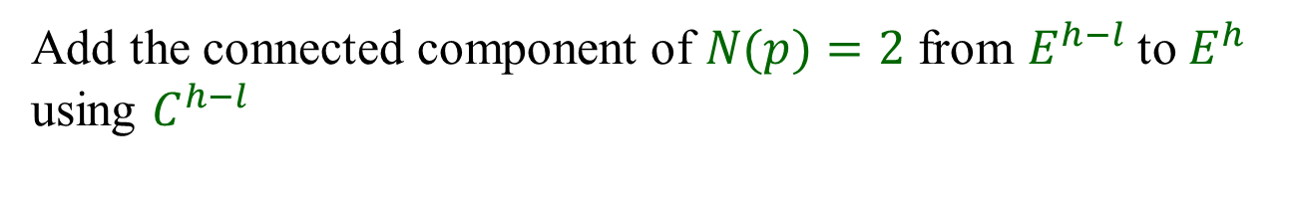


 | 2
 | 2 |  |  | 1 | 1 | 1
 | 2
 | 2
$$E^{h}$$
$$C^{h−l }\text{to} \text{be} \text{the} \text{labeled} \\ \text{of} \text{connected} \text{components} \\ \text{in} E^{h−l}$$
$$Result$$
Add the connected component of $N(p)=2$ from $E^{h−l}$to $E^{h}$ using $C^{h−l }$

Slide 43
Geometry
Image formation
Geometry – point location
Radiometry – point color
Recovering -3D shape
Two or more images
Mathematical tools:
Euclidean geometry
Projective geometry

Slide 44


Why 3D?
Applications:
Object recognition
Navigation
Graphics
Augmented data
Virtual reality

Slide 45

Camera Obscura
First photograph: 1829 J. Nicéphore Niépce

Slide 46





Cameras
מצלמה דיגיטלית
מצלמות של פעם
מצלמת רשת
קמרה אובסקורה

Slide 47


Image Formation
Location in the 2D image
The 3D point location with respect to the camera
The camera optics

Slide 48
Projection Models
Perspective
Orthographic
Paraperspective
Affine
Later in the course

Slide 49


The Pinhole Camera
Infinitesimally small aperture.
Straight rays of lights travel through the aperture to the image plane
Each scene point projects to a single image point
Pinhole
Image
Object
Screen
Principal
point

Slide 50

The Camera and the Eye

Slide 51
The Image Plane
Image
Plane
COP
COP
Image
Plane

Slide 52
Pinhole Camera Geometry
y
image point
x
y
Object point
x
z
Center of
Projection (COP)
principal axis
Image
Plane
principal point

Slide 53







Perspective Projection
f: the focal length
COP
z_{object}
Image
Plane

Slide 54



Perspective Projection
COP
z_{object}
Image
Plane

Slide 55
Ambigutiy
+

Slide 56
Two Images
!
+
+

Slide 57


A Stereo Pair
Left image
Right image

Slide 58

Stereo Vision
Output: the 3D shape of the scene
Input: two images
from two viewpoints
Natural visual system
!

Slide 59

Taken from: http://www.stereoscopy.com/3d-info/

Slide 60
Correspondence
+
+

Slide 61
Correspondence
+
+

Slide 62
Correspondence
+
+

Slide 63
Correspondence
Ambiguous correspondence occurs often
Cop
Cop

Slide 64
Stereo: Main Issues
Point correspondence
Camera calibration
Triangulation: Given correspondence and calibration, reconstruct the 3D geometry of the shape
+
+

Slide 65
Triangulation
Object point
Left Image
Right Image
+
+
Cop
Cop
principal point
Notes:
When the two image planes and the center of projecions are known, it is possible to compute the 3D location of a point from the two images.

Slide 66
A Simple Stereo System
Object point
The two camera planes are coplanar
The two optical axes are parallel
The two focal lengths are identical
The fixation point lies at infinity
The correspondence is given
f
f
Left Image
Right Image
α
β
+
+
Cop
Cop
Notes:
When the two image planes and the center of projecions are known, it is possible to compute the 3D location of a point from the two images.

Slide 67
Next
General camera
Projective Geometry:
Definitions
Camera projection matrix
Then:
Stereo
Epipolar Geometry
Homography
SFM

